Slide 1

KAPASA MAKASA UNIVERSITY
Research Methods (AA400/ AA300)
Lecture IV – Literature review
Mrs Sarah Ng’andwe Tembo
Dept of Agric and Aquatic sciences
March 2026

Slide 2
The Process So Far
What is the Problem?
Why Should it be studied?
Literature & other available information
What information is already available?

Slide 3
Definition of Literature Review
It is the exploration, analysis and critical discussion of studies that have been conducted in order to discover their relationship with an identified problem (or proposed study)
The underlying principle is that; the more one knows about studies conducted in areas related to a proposed study the more knowledgeable and more equipped one is to investigate the identified problem (or to conduct their own study)

Slide 4
Fundamental question?
  What is known about a particular topic
  What needs to be known
It is important to convince the reader that the research problem is well understood.
Literature review may point out to inconsistencies or disagreements among findings
The literature review should introduce the reader to the topic of interest, laying out in a logical manner what has already been learnt in a topic by past researchers, then leading to the holes or loose ends in the knowledge of the topic.

Slide 5
What are the challenges?
Too little material available
Too many publications to deal with meaningfully
Don’t know how to access literature needed
Don’t know how to structure the information
Afraid of forgetting to include important facts
Don’t know how and where to begin

Slide 6
The Purpose of a Literature Review
To explain the historical background of a topic
To describe and compare the schools of thought on an issue
To synthesize the available research
To highlight and critique research methods
To note areas of disagreement
To justify the topic you plan to investigate

Slide 7
Purpose of the Review
To sharpen and deepen the theoretical/conceptual framework for the study taking an interdisciplinary approach where possible
To identify knowledge gaps in order to avoid re-inventing the wheel or making the same mistakes
To familiarize the researcher with the latest development in the area of research as well as in related areas-
Literature review helps the researcher to refine the research topic/problem. A researcher should be acquainted with the problems, hypothesis, and results obtained by previous studies in order not to duplicate efforts.

Slide 8
Purpose of the Review
To discover connections, disconnections, analogies, or relations between different research results by comparing various investigations
To identify variables that must be considered in the study
To identify weaknesses and pitfalls other researchers have fallen into.
To identify and compare methodologies used by others in relation to those one intends to use
To identify other researchers in the subject for possible areas of collaboration

Slide 9
How to write the section on the related literature
Review the literature; don’t reproduce it
  Present your own discussion
  Paraphrase
  Use short direct quotations if necessary
  Long direct quotations are a last resort. Use them only for a very good reason

Slide 10
How to write the section on the related literature
Showing the relatedness of the literature review to the research problem
  Write your problem at the top of the page where you cannot lose sight of it. In this location you will be constantly reminded of the central axis around which everything else revolves
    Example problem: “How can smallholder farmers in Zambia improve soil fertility using sustainable practices without increasing production costs?”
  Dissect the problem by numbering its various subparts
  Divide the page into two columns by drawing a vertical line down the middle of the page, starting below the statement of the problem
  Cite each specific study in the left-hand column
  In the right-hand column, opposite each study, note the particular sub-division of the problem to which the study relates and note also the rationale for including it.

Slide 11
  Gather together all the citations that refer to a particular aspect of the problem, so that you have as many groups you have sub-divisions of your main problem
  Study these groups in relation to each other, with the view of planning and organizing the discussion of the related literature.
  Write the review. Head each section with headings whose wording contains the identical words found in statement of the problem

Slide 12
If you discover you have not yet found literature or information on some aspects of your problem that you suspect are important, make a special effort to find this literature.
If there is no literature, this supports your justification for conducting the study.
Conclude by explaining how your study will add to the body of knowledge

Slide 13
Writing a Review Ethical Considerations
Appropriate referencing (quoting authors) is critical in research proposal (scientific fraud!!!)
Poor authorship
  Raises questions about the integrity of the researcher
  Puts readers who want to use study findings on the wrong track
  Leads to waste of time and money conducting research that is not applicable
  Leads to wrong decisions

Slide 14
Reliability and Validity of Information
Use only authentic sources of information
How reliable is the information, especially from reports, documents without peer review?
  E.g. use of internet sources not recognised as scholarly. Blogs, Wikipedia, or commercial websites are not reliable for academic work. They can be used for background understanding but not as citations in a proposal.
Consider internal and external validity of scientific articles

Slide 15
Searching the Web
Use search engines
  Google Scholar
  Google
  Web of Science
Research gate
  Searching for prominent authors, profiles and their publications.

Slide 16
Validity and Reliability
Validity means that conclusions are true
Internal validity is the degree to which the results of a study are correct for the sample or units being studied.
Determined by how well the design, data collection and analyses are carried out .Threatened by several biases
External validity is the degree to which the results of an observation hold true in other settings i.e. Generalisability
Reliability means that someone using the same method in the same circumstances should be able to obtain the same findings

Slide 17
Common Problems
DO NOT:
Include every source found
Include every source in a sequential order
Organize the discussion in an ineffective manner
Lose track of sources and spend time searching for them

Slide 18
Transitions
Transitions help connect paragraphs together
Examples:
One of the first researchers to investigate this problem is Chen . . .
Smith and Jones counter Chen’s argument . . .
The issue becomes more complex when a third school of
thought is considered . . .
One researcher who agrees with Chen is . . .
A different approach to this question looks at problems in X
One of the most troublesome problems is addressed by Green . . .
A problem with this approach is that . . .
A recent study adds this to the mix . . .
A crucial issue that has not been addressed is z . . .

Slide 19
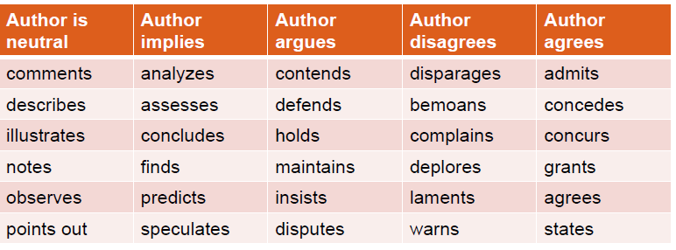
Word Choice
Example:
1. Lal (2021) notes that soil carbon sequestration can mitigate climate change.
2. Vanlauwe et al. (2022) concludes that integrated soil fertility management improves yields under certain conditions
3. Thornton et al. (2023) concurs with FAO (2022) that climate-smart agriculture requires farmer training

Slide 20
Tips for Success
Look at other literature reviews in your area of interest or in the discipline
Keep track of sources
Give yourself time for multiple drafts
Have someone in your field read your literature review

Slide 21
Literature & Information Sources
Types of Sources
Tertiary
Secondary
Primary

Slide 22
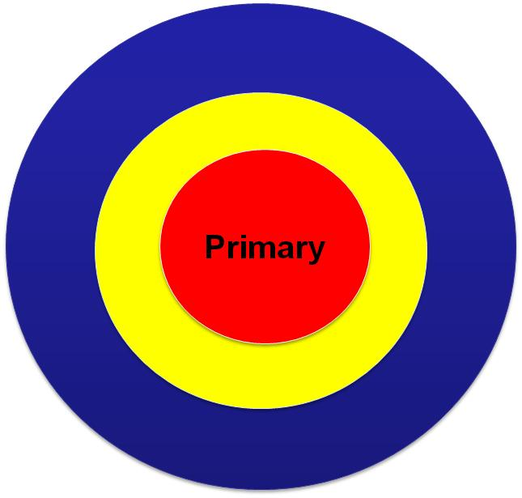
Information retrieved directly from the original sources
  Eyewitness reports
  Personal communications
  Government publications
Experienced professionals, lecturers and researchers may be considered as primary sources

Slide 23
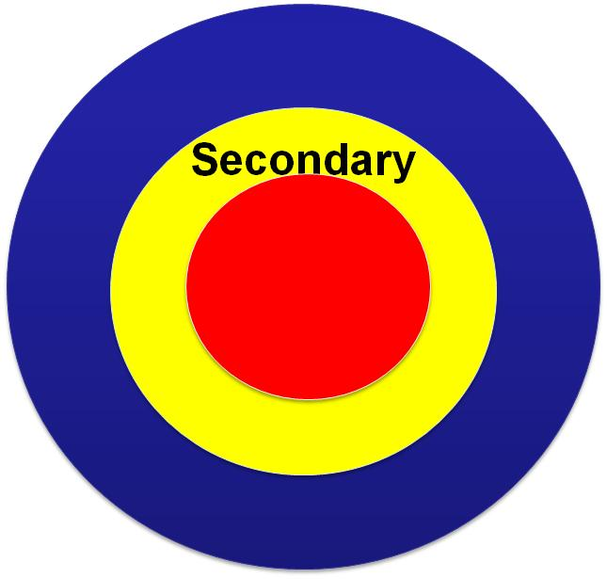
Comprise information that has been processed by other people.
Information is drawn from primary sources such as :
  Research reports
  Books
  Journal articles
  Summaries and Reviews

Slide 24
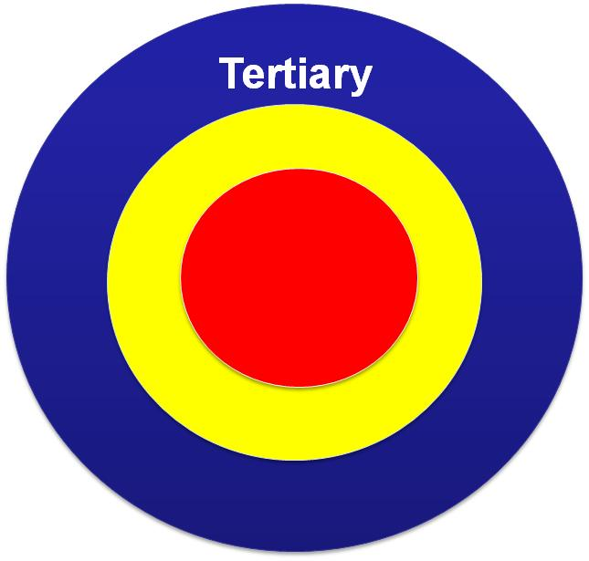
Information is compiled from secondary sources
  Encyclopedias
  Dictionaries

Slide 25
Evaluating the quality of Internet Materials
Is the author or institution clearly identified?
Is the site advocating a point of view?
Does the website give accurate and complete references?
Are the data up-to-date?
Does the data seem consistent with data from other sites?

Slide 26
Reviewing Technique
Select a number of relevant publications
  Especially review articles on the topic
Review for use in the study

Slide 27
Reviewing Technique
What to look for?
  Full references, including topic or title or name(s), name of journal, book etc in which publication appears and date and place of publication

Slide 28
Reviewing Technique
What to look for?
  Purpose and hypothesis, which should include a summary of the problem, indicate the hypothesis to be tested, the variables at stake etc

Slide 29
Reviewing Technique
What to look for?
  Methodology, comprising a description of the population and the sample, of the design, the instruments of measurement and the method(s) of analysis (statistics)

Slide 30
Reviewing Technique
What to look for?
  Findings and conclusions, which should incorporate a summary of the results and their interpretations stated and the consequences suggested by the author(s)

Slide 31
Steps in conducting a literature review
Search for literature
  Use structured approach
  Careful selection of search terms
    Use of Boolean Terms: AND ; OR ; NOT
    Keep a record of search terms / Save searches
  Identification of relevant databases
    MDPI forestry
    Agroforestry systems
  Identification of relevant journal publishers e.g.
    African Journals Online
    ScienceDirect

Slide 32
Steps in conducting a literature review
  Electronic searches of individual key journals
  Use existing literature reviews and systematic reviews
    Good overview of research already conducted
  Acceptable time frame - 5-10 years
    Unless referring to seminal or influential articles

Slide 33
Exploiting the literature
How should you read?
  Cover to cover?
  Read parts?
  Dip into?
  Read it again and again?
  Read it anywhere? Anytime?

Slide 34
Exploiting the literature
How should you read?
  First read – abstract
    Decision to include or exclude
    Categorise – according to
      Theme
      Type of source
        Journal or book
        Primary
        Secondary
        Conceptual or theoretical

Slide 35
Exploiting the literature
How should you read?
  Second read – PQRS system
    Preview - from selected papers decide what to keep and what to discard
    Question – ask questions of each study as you study
    Read
    Summarise

Slide 36
Example
Most of the professional and scholarly literature on sustainable agriculture in recent years has emphasized large-scale or commercial farming systems, often overlooking the realities of smallholder farmers in sub-Saharan Africa. Kassam et al. (2020) provides a global overview of conservation agriculture, focusing primarily on mechanized systems in Latin America and Asia. Similarly, Lal (2021) highlights soil carbon sequestration as a climate mitigation strategy, but his examples are drawn largely from industrialized contexts. Vanlauwe (2022) discuss integrated soil fertility management in Africa, yet their case studies concentrate on pilot projects with significant donor support rather than everyday smallholder practices. Review articles on agroecology (Altieri & Nicholls, 2020; Wezel et al., 2021) emphasize biodiversity and ecological resilience but devote limited attention to economic feasibility for resource-poor farmers. Studies on climate-smart agriculture (Thornton et al., 2021; FAO, 2023) highlight adaptation strategies such as drought tolerant crops and digital advisory services, yet most examples are drawn from large-scale demonstration farms. Even systematic reviews of organic farming (Smith et al., 2024; Rigby, 2025) tend to focus on European and North American contexts. Professional journals such as Agricultural Systems and Sustainability have published numerous articles on sustainable farming between 2020 and 2026, but the majority feature large commercial farms or global policy frameworks (Giller et al., 2020; Pretty, 2025). This creates a clear gap in the literature: the specific challenges and opportunities of smallholder farmers in Zambia and similar regions remain underexplored, particularly in relation to balancing soil fertility improvement with cost constraints.

Slide 37
Bias in literature
Bias in literature or review of the literature is a distortion of the available information in such a way that it reflects opinions or conclusions that do not represent the real situation
  Playing down controversies and differences in one’s own study
  Restricting references to those supporting view of author
  Drawing far reaching conclusions from preliminary or weak results, making sweeping generalisations from a study with little external validity (case study or small study)

Slide 38
Biased Literature Review Example
Recent studies prove that zero-grazing systems are always the best option for dairy farmers. Mwangi (2021) shows higher milk yields, and Banda (2022) confirms improved animal health. Since these studies demonstrate clear benefits, zero-grazing should be adopted by all farmers without question.

Slide 39
Unbiased Literature Review Example
Research on zero-grazing systems in dairy farming shows mixed outcomes. Mwangi (2021) reports higher milk yields under controlled feeding, while Banda (2022) notes improved animal health. However, Phiri (2023) highlights that labor and feed costs can limit adoption among smallholder farmers. Other studies suggest that semi-intensive systems may be more feasible in resource-poor contexts (Kunda, 2024). These findings indicate that zero-grazing can be beneficial, but its success depends on local conditions, and alternative systems may be more suitable for some farmers

Slide 40
Important
Do not be influenced by the results of previous research and fail to discover new possibilities and to observe objectively without preconceptions

Slide 41
Plagiarism
What is plagiarism?
Plagiarize:
  to steal and pass on information, ideas or words of another person as one‘s own without crediting the source
  To commit literacy theft
  Presenting as new and original an idea or product derived from an existing source

Slide 42
Examples of Plagiarism
Copying text from a book or article without citation.
Paraphrasing someone’s idea but failing to credit the source.
Submitting another person’s work (essay, report, data) as your own.
Using figures, tables, or images without attribution.
Example of a plagiarized sentence:
    Organic farming improves soil fertility and reduces environmental impact.
  Correct version
    According to Mwanza (2021), organic farming can improve soil fertility and reduce environmental impact.

